Slide 1








INVOICE & RECEIPT DIGITIZER
Automated Invoice Processing and Expense Analysis System
MENTOR: Shakthi Gopalakrishnan
Presentation by: Team B

Slide 2


Our Team
Srushti Y
Ayisha
Leela Krishna
Team Member 1
Team Member 2
Team Member 3
FRONTEND
BACKEND & AI
DATABASE
Designed dashboard UI interface
• Implemented UI layout and navigation
• Integrated upload functionality & OCR reseach • Developed analytics charts and dashboard visualization
Implemented API for invoice processing
• Managed file upload and OCR processing logic
• Handled server-side validation and data flow
Designed the database schema for users and invoices.
Managed storage of uploaded invoice files and metadata.

Slide 3



OBJECTIVE
Managing physical invoices and receipts manually is time-consuming and error-prone. Important financial data is often difficult to organize, track, and analyze.
To develop an Invoice Digitizer System that:
• Converts physical invoices into digital records
• Automatically extracts key information using OCR
• Stores structured invoice data
• Provides analytics and insights on expenses

Slide 4


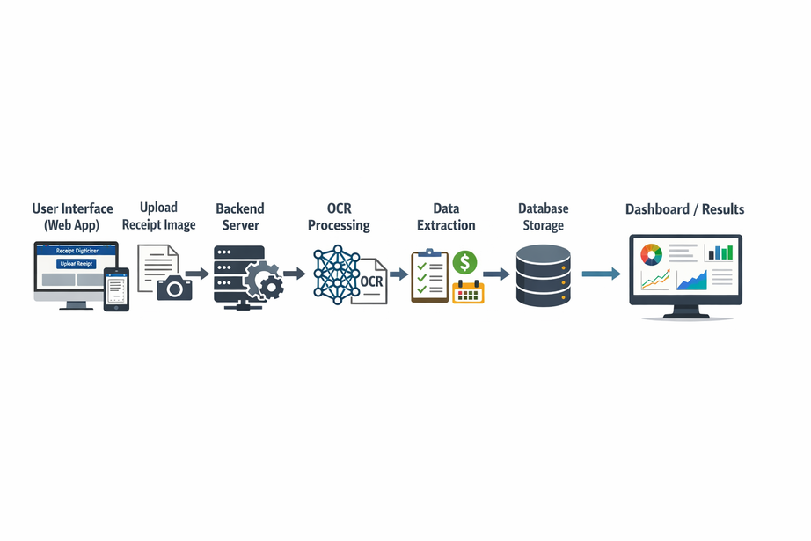


Architecture & Workflow
System Workflow
1️⃣ User uploads receipt/invoice
2️⃣ System processes the image using OCR
3️⃣ Important information is extracted automatically
4️⃣ Extracted data is converted into structured digital format
5️⃣ User can verify and edit extracted data
6️⃣ Data is stored in the database
7️⃣ Dashboard displays expense analytics and insights
Architecture Layers
• Frontend (React UI)
• Backend (API Processing)
• Database (Invoice Data Storage)

Slide 5




Technology Stack
Frontend
• React.js
• CSS, HTML5
• Chart.js for analytics visualization ,js(ES6)
1
Backend
FastAPI
python
AI
Tesseract OCR
Gemini for chatbot
2
Database
SQLITE
3

Slide 6
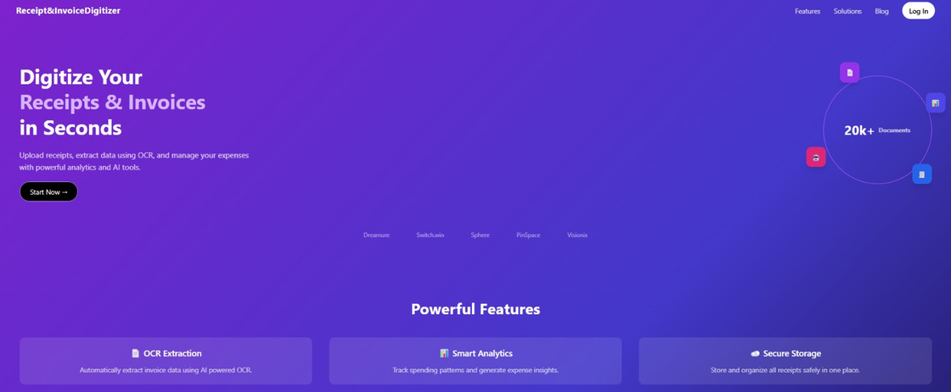

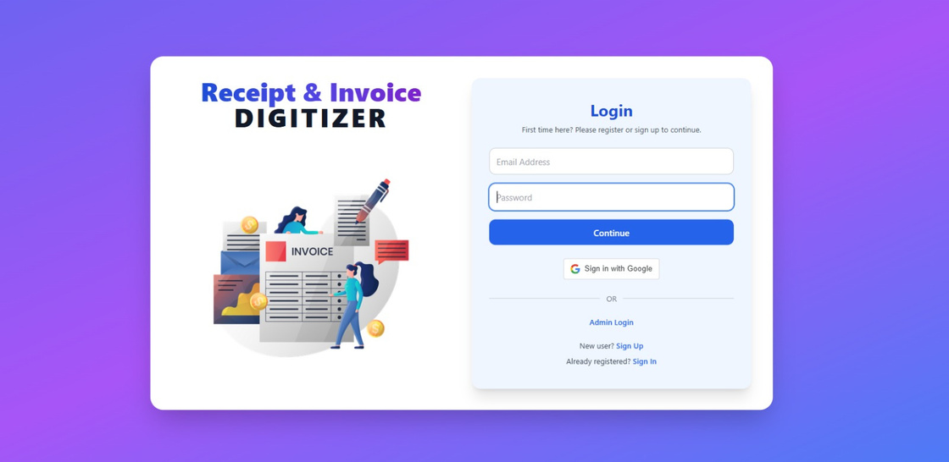
System Interface (Screenshots)
Landing Page
• Introduction to the system
• Login / Sign Up access
Login Page
• User authentication
• Secure access to dashboard

Slide 7
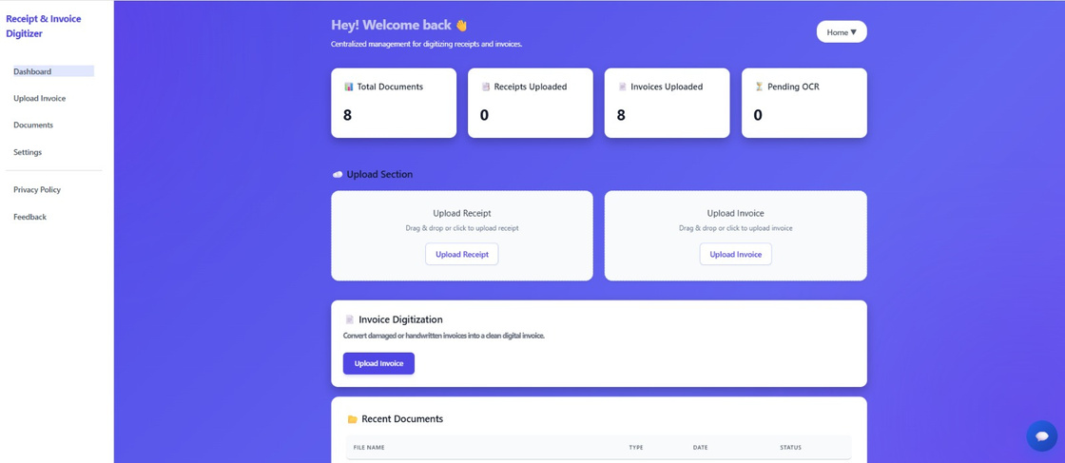
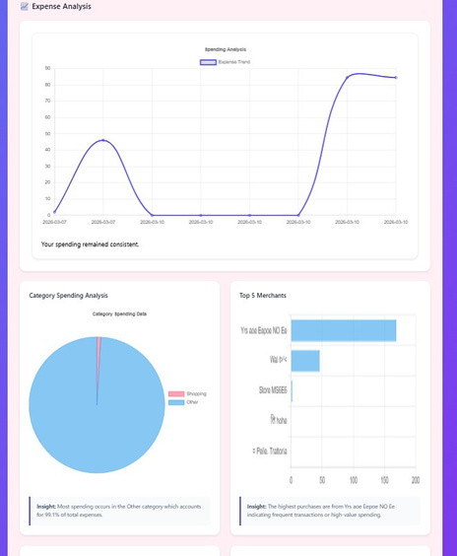
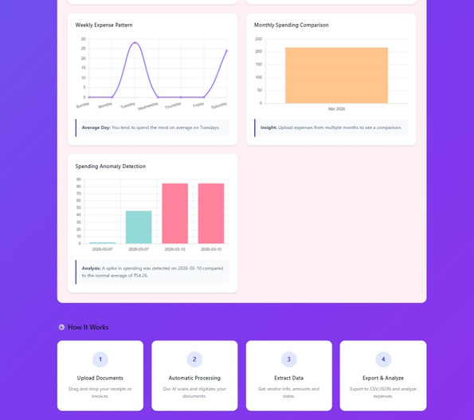
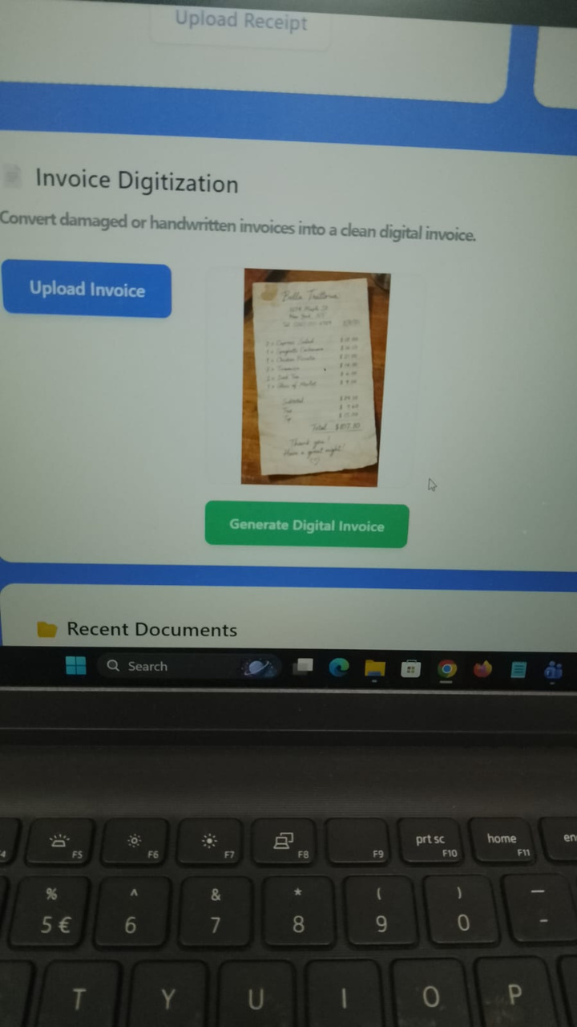
System Interface (Screenshots)
Dashboard
• Upload receipts/invoices
• Recent documents
• Analytics visualization

Slide 8
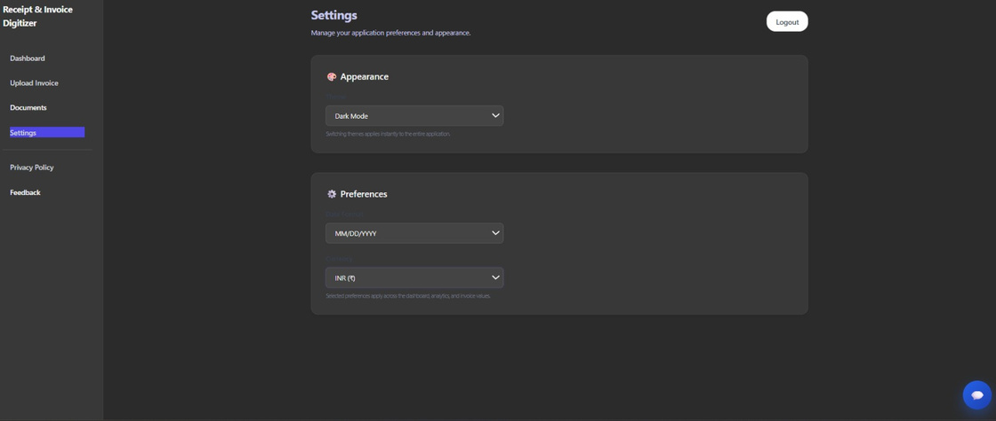
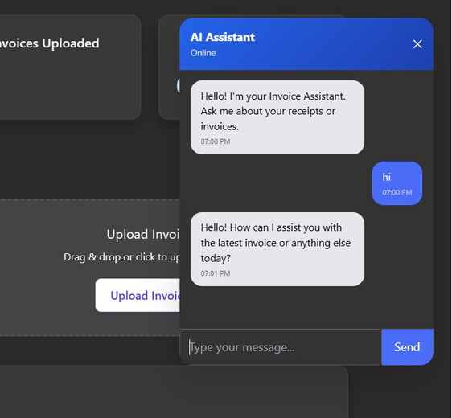
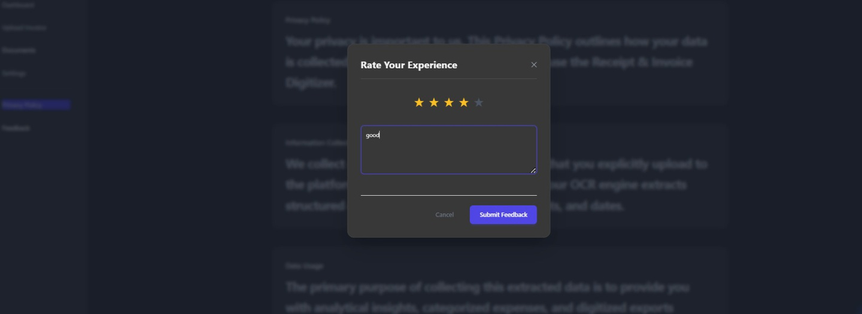
System Interface (Screenshots)
SETTINGS PAGE
DARK /LIGHT MODE
DATE &CURRENCY PREFERENCES
FEEDBACK &SUGGESTION SUPPORT
CHAT BOT

Slide 9
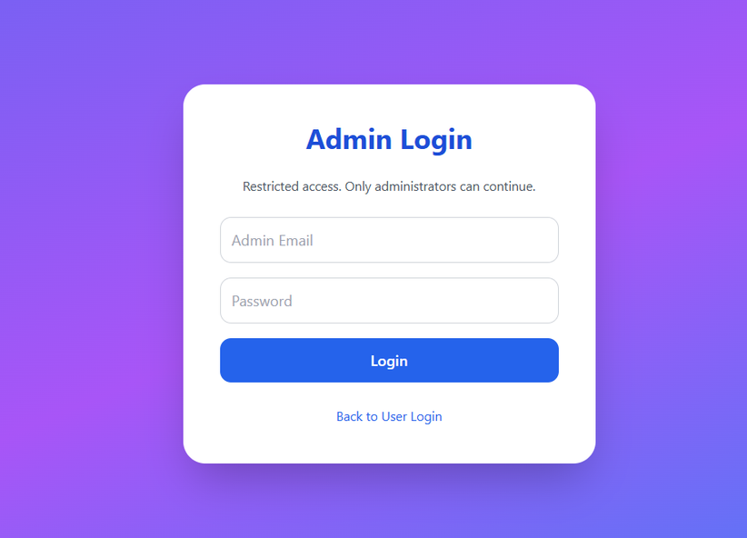
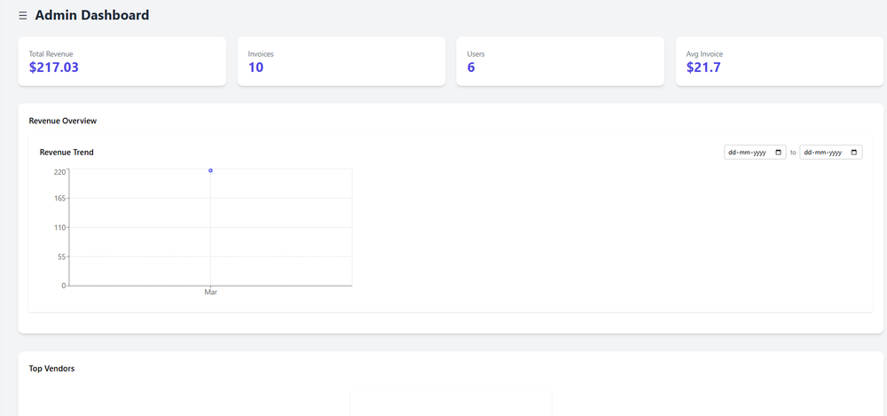
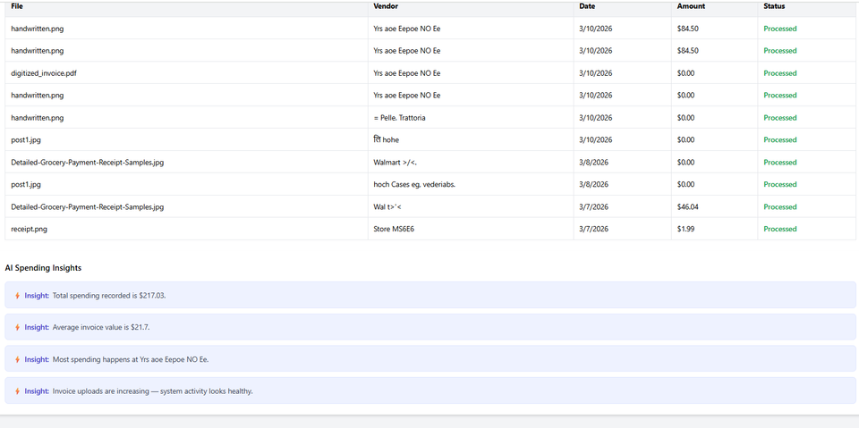
System Interface (Screenshots)
ADMIN PAGE
admin authentication
visual dashboard
user registered analyis

Slide 10
Feature Enhancements
Improved Dashboard UI
• Blue-purple gradient layout for modern interface
Auto-Scroll Navigation
• Clicking Documents in sidebar automatically scrolls to the Recent Documents section
Expense Analysis Visualization
• Analytics chart to track spending patterns
Invoice Data Verification
• Users can preview and edit extracted invoice data
Interactive Chat Assistant
• Built-in assistant to guide users within the dashboard

Slide 11

CHALLENGES FACED
• OCR Accuracy Issues – Difficulty extracting text from handwritten or low-quality receipts.
• Receipt Format Variations – Different layouts made field detection inconsistent.
• Image Quality Problems – Blurry, tilted, or poorly lit images reduced OCR accuracy.
• Data Structuring – Converting raw OCR output into structured fields required extra processing.
• System Integration – Coordinating frontend, backend, OCR, and database components.
• Chatbot Integration – Ensuring the chatbot provides useful and accurate responses.
• UI Design – Building a simple and user-friendly receipt upload interface.
• Database Management – Organizing and retrieving receipt data efficiently using SQLite.
• Testing – Validating the system with various receipt types and formats.
• Time Management – Managing development, testing, and documentation within deadlines.

Slide 12
Conclusion
The Invoice Digitizer System simplifies invoice management by converting physical receipts into structured digital records.
Key Benefits
• Reduces manual data entry
• Improves financial record organization
• Enables expense analysis through visual insights
• Provides a scalable system for invoice management

Slide 13



Future Enhancements
Use Azure Blob Storage for secure and scalable invoice storage
Automatic data extraction from receipts using Amazon Textract
AI-based expense categorization (Food, Travel, Office, etc.)
Advanced search and filters for invoices

Slide 14




THANK YOU

